Slide 1

Applied data science capstone – relocation Assistant
Submitted for coursera study

Slide 2
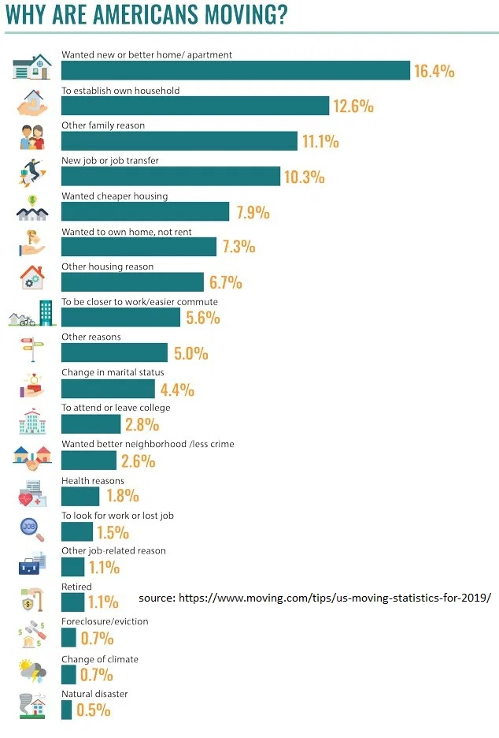
Business problem
Americans relocate from one place to another for different reasons (as shown in the graphic on the adjacent side)
People could use a tool / application that takes the profile of the person along with the requirements, and suggest a set of zip codes / neighbourhood for the person to consider exploring
For the purpose of this implementation., Los Angeles and its suburbs are considered
Data is crowd sourced, and scraped from various public web based sources covering various aspects of a geography that affects living preferences
The goal is to create a segmentation of various zipcodes based on various living preferences for the user to select exploring

Slide 3
Data sources
The data for this study includes factors that affect one’s choice of living in a certain area (the area being Los Angeles for this study)
The variables used for clustering are population, number of household, size of the household, median age, shooting incidents involving human, shooting incidents involving animals, top 4 most common venues of that neighbourhood – all by zip codes
Zip code information:
https://namecensus.com/igapo/zip_codes/counties/alpha/Los Angeles County-California1.html
https://namecensus.com/igapo/zip_codes/counties/alpha/Los%20Angeles%20County-California1.html
http://download.geonames.org/export/zip/ (downloaded the USZipcodes.zip)
Census: https://catalog.data.gov/dataset/2010-census-populations-by-zip-code
Population by Zip codes: https://www.zip-codes.com/city/ca-los-angeles.asp
Latitude / Longitude: "https://gist.githubusercontent.com/erichurst/7882666/raw/5bdc46db47d9515269ab12ed6fb2850377fd869e/US%2520Zip%2520Codes%2520from%25202013%2520Government%2520Data"
Shooting Incidents: https://data.lacounty.gov/Criminal/All-Shooting-Incidents-for-Deputy-Involved-Shootin/d5zc-33fr

Slide 4
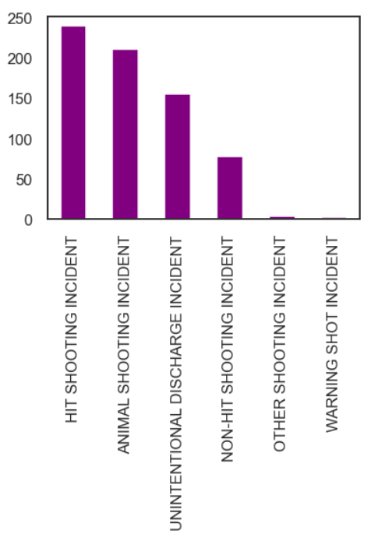
Data preparation and cleansing
Data is cleansed to remove duplicates, missing values etc.
Missing values are sourced / substituted from other data sources from across the Internet to construct a complete dataset
Venue information was added (using Foursquare APIs)
Shooting incidents are added using a crime incident database. Since not all shootings are equal –
Animal related shootings are used as a single feature / variable: Those who see risk in living in a neighbourhood with lot of wild animals may prefer to avoid those neighborhoods that involve high animal sightings and shootings
Non Animal related, but shooting incidents of concern: These include any kind of shooting, including warning shots etc
Shootings causing hit / human injury
As shown in the chart, there have been significant number of shooting incidents in a given year

Slide 5


Overall approach to Feature engineering & clustering
Shooting Incident Type Shooting Incident Date Shooting Incident Location City State
Zip
Reporting District
Geo Location
Handling Unit ID
Handling Unit Name Approximate Latitude Approximate Longitude
Zipcode
Population
Median Age Total Males
Total Females
Total Households
Average Household Size
Zipcode
Latitude Longitude
Zipcode City
Foursquare APIs
Zipcode
Latitude & Longitude Venue & Categories Population Median Age Total Males Total Females Average Household Size
Shooting incidents
1st Common Avenue
2nd Common Avenue
3rd Common Avenue
clustering

Slide 6
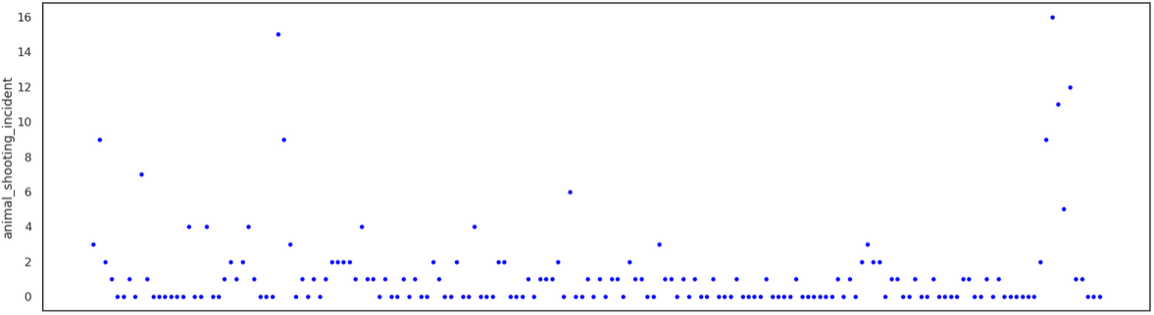
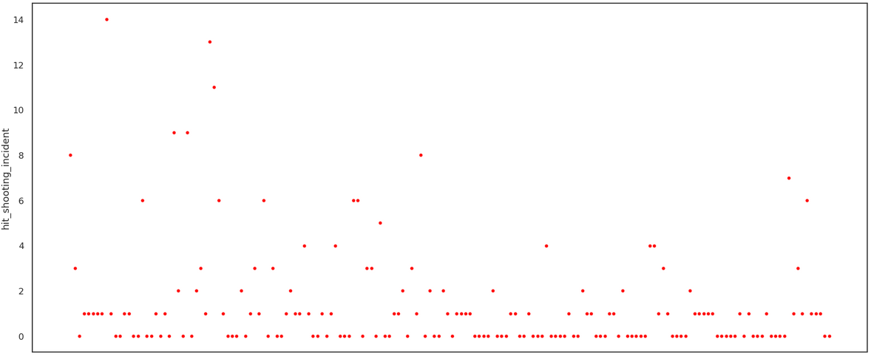
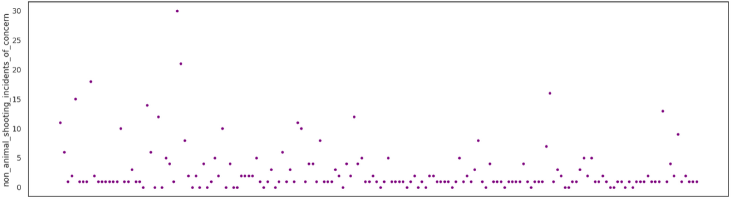
Shooting incident scatter
As shown in the charts, shooting incidents are elevated in some areas / zip codes
Animal shooting could involve wild animals and other ones that could spread disease
Shootings involving human injury (hit) could be particularly prone to high crime rates
The yearly statistics of all these shooing incidents could vary by zip code and regions

Slide 7
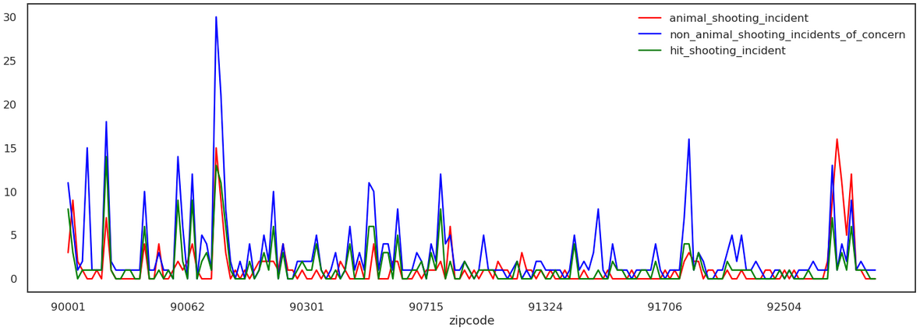
All three types of shooting compared against zip codes
As shown in the plot above, there are areas with significant episodes of all kinds of shootings, and they seem to be concentrated to certain localities more than the other

Slide 8
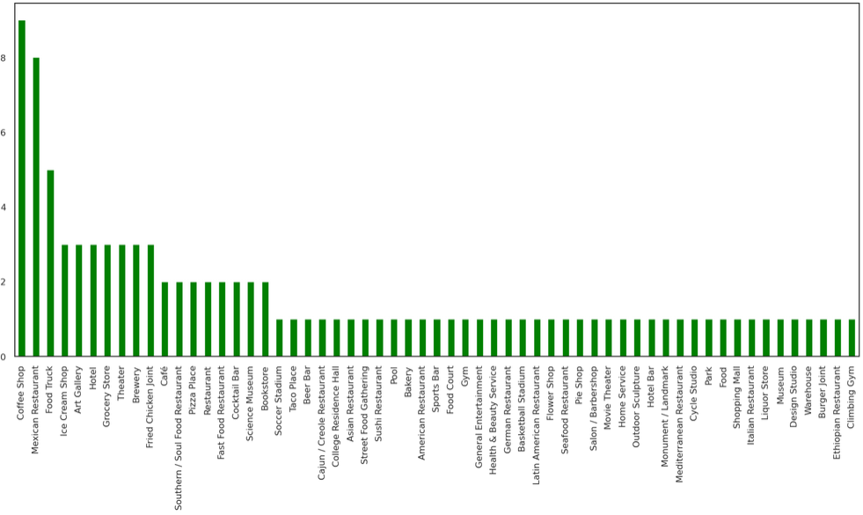
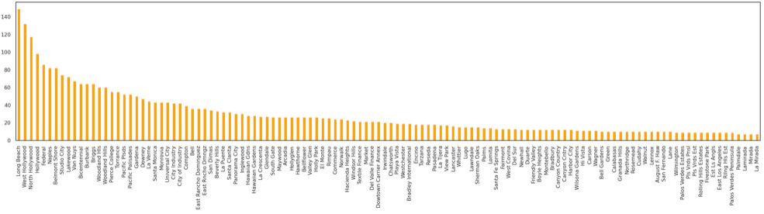
Categories added using foursquare APIs
The plot shows the number of venues added using Foursquare APIs across the zip codes to enrich the feature set

Slide 9
Discussion of results

Slide 10
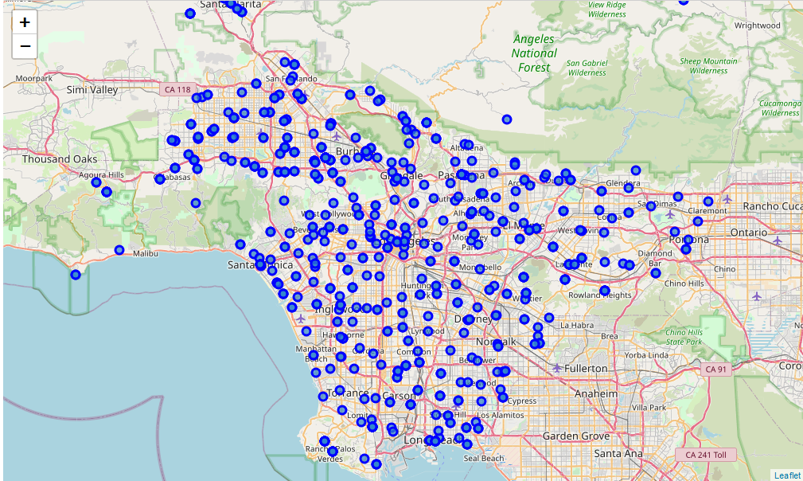
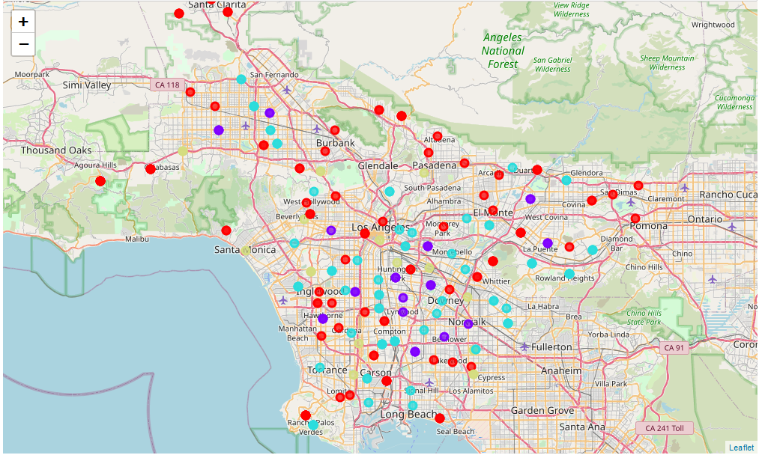
Coverage area of los angels with and without clustering
Cluster 1
Cluster 2
Cluster 3
Cluster 4
As maps show above, the area represented on the left with venues, is clustered on the right in terms of population, number of households, avg median household age, shooting incidents, and the top four most common venues that are found in the neighborhood. Expanding the area can result in more meaningful clusters

Slide 11
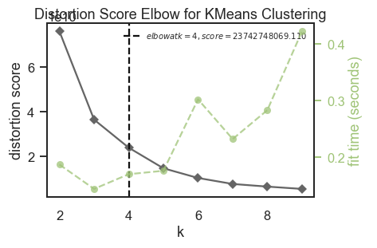
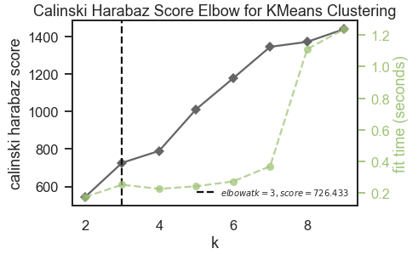
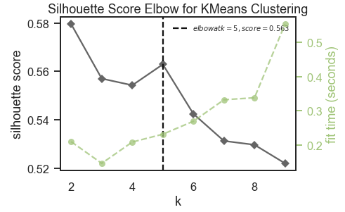
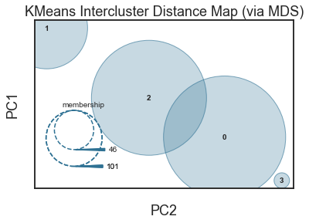
Cluster metrics and determination of number of clusters
As shown here multiple metrics are tried to find the optimum number of clusters. 4 clusters seem to result in the best outcome

Slide 12
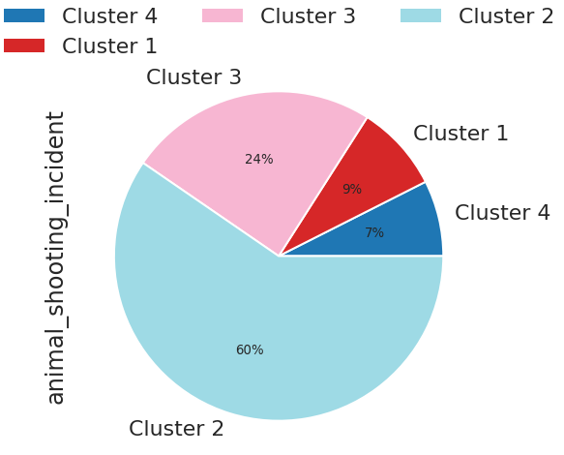
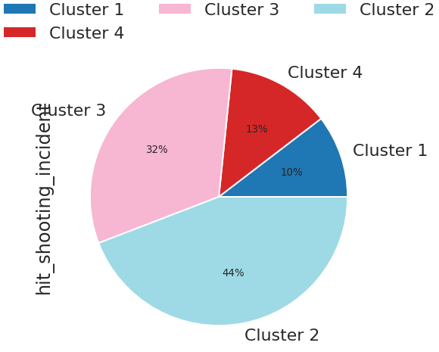
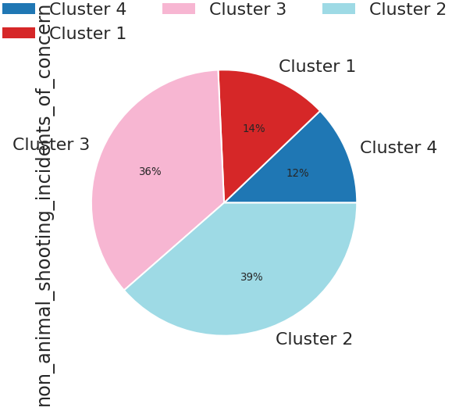
Cluster comparisons – by Shooting incidents
The charts show how the clusters compare with respect to various types of shooting incidents – Animal shooting, Shooting of a human being on another causing a hit, and all types of human shooting including warning shots. It is clear from the analysis that
Cluster 2 is the worst when it comes to high rate of shooting incidents of various kinds, but has many shopping and mall areas
Cluster 3 follows cluster 2 closely
Cluster 4 is arguably the safest from the standpoint of shooting and Gun related crime
Cluster 1 is the next to the cluster 4 when it comes to safety from Gun related crimes

Slide 13
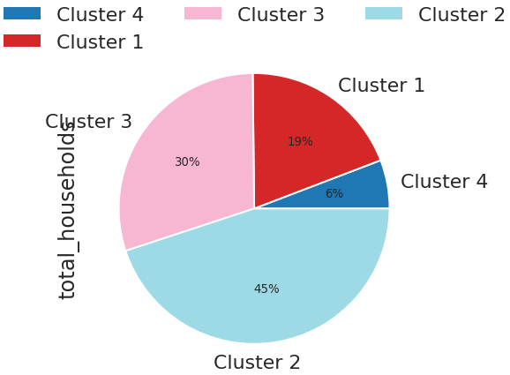
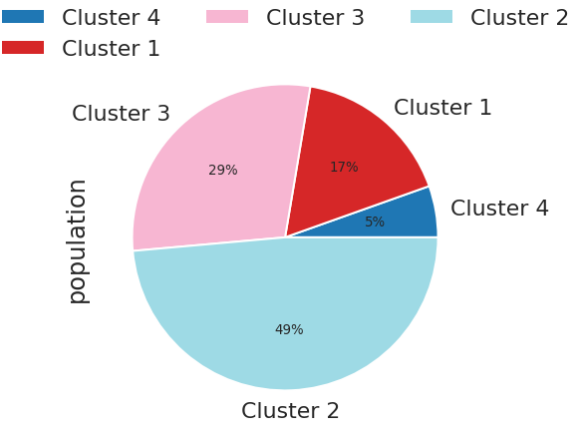
Cluster comparisons – by population and household
The charts show how the clusters compare with respect to total number of household, and population. It is clear from the analysis:
Cluster 2 ranks high when it comes to high population and number of households. This has a positive and negative implications for people who relocate. Likely to include many communities, restaurants, and shops, while less of natural landscapes
Cluster 3 is a close cousin of cluster 2, like in the case of shooting incidents
Cluster 4 is arguably ideal one for sparsely populated area
Cluster 1 is one with less population with good blend of natural outdoor areas

Slide 14
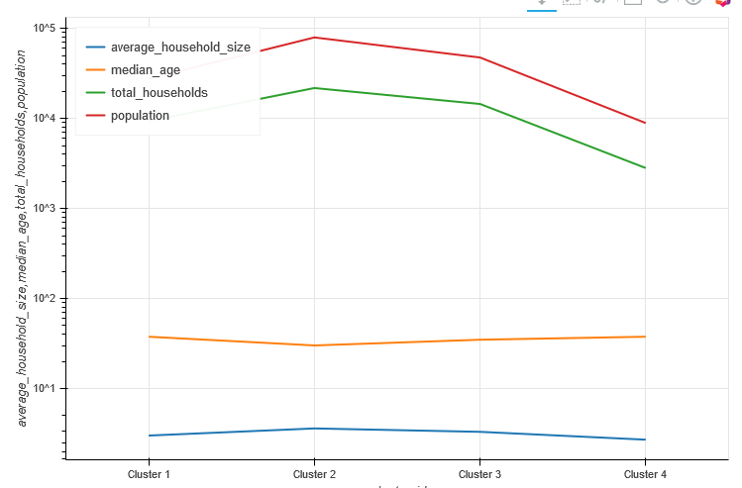
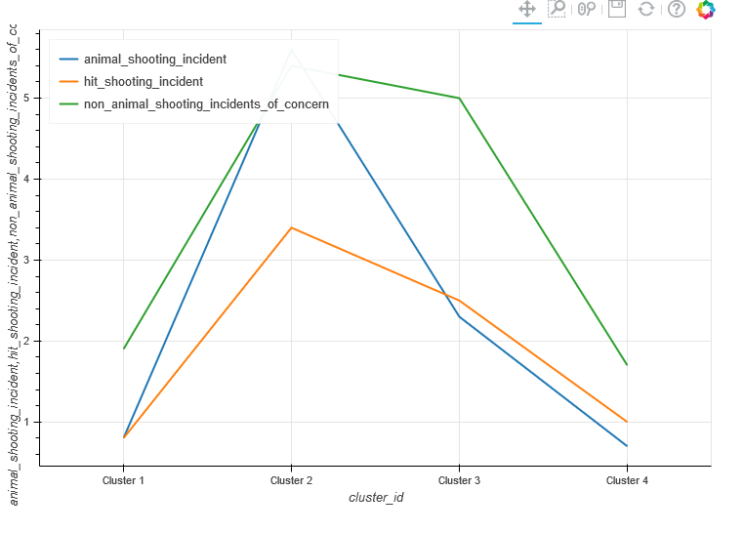
Cluster comparison in terms of features
The line plots show the feature wise comparison of the clusters for easier illustration and comparison

Slide 15
Cluster definitions and comparison across the features
Cluster ID | Mean Population | Mean Age | Number of Households | Avg Household Size | Shooting involving Human injury | Non-Animal Shooting Incidents Of Concern | Animal Shooting Incident | 1st Most Common Venue | 2nd Most Common Venue | 3rd Most Common Venue | 4th Most Common Venue
1 | 27705 | 37.60 | 9390.6 | 3.0 | 0.8 | 1.9 | 0.8 | Trail | Coffee Shop | Park | Park
2 | 79555 | 30.09 | 21789.6 | 3.6 | 3.4 | 5.4 | 5.6 | Mexican Restaurant | Mexican Restaurant | Shopping Mall | Pizza Place
3 | 47588 | 34.83 | 14497.2 | 3.3 | 2.5 | 5.0 | 2.3 | Mexican Restaurant | Mexican Restaurant | Home Service | Pharmacy
4 | 8896 | 37.61 | 28145 | 2.7 | 1.0 | 1.7 | 0.7 | Mexican Restaurant | Mediterranean Restaurant | Ice Cream Shop | Yoga Studio

Slide 16
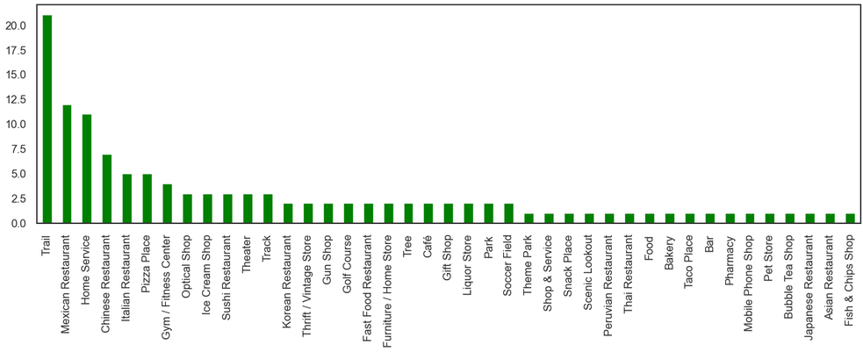
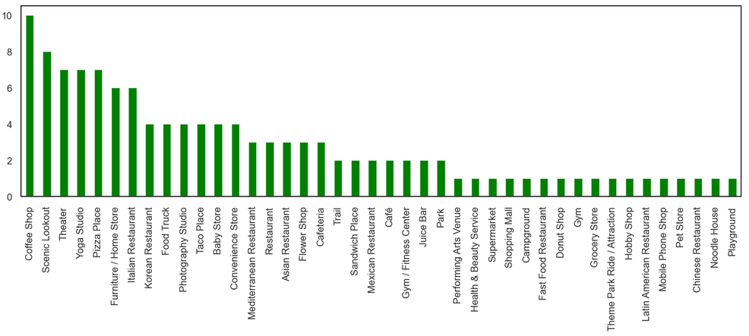
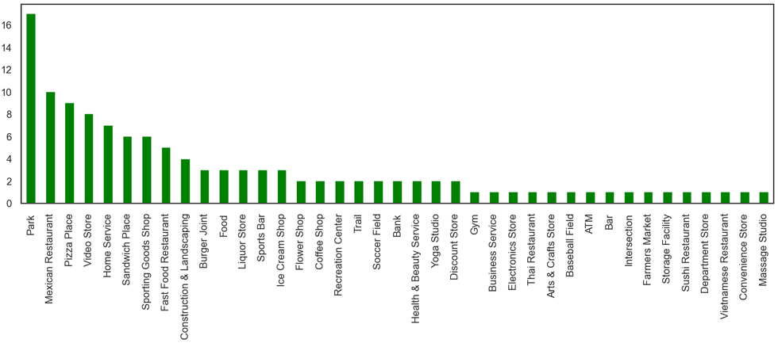

Top 4 most common avenues for cluster 1
1
2
3
4

Slide 17
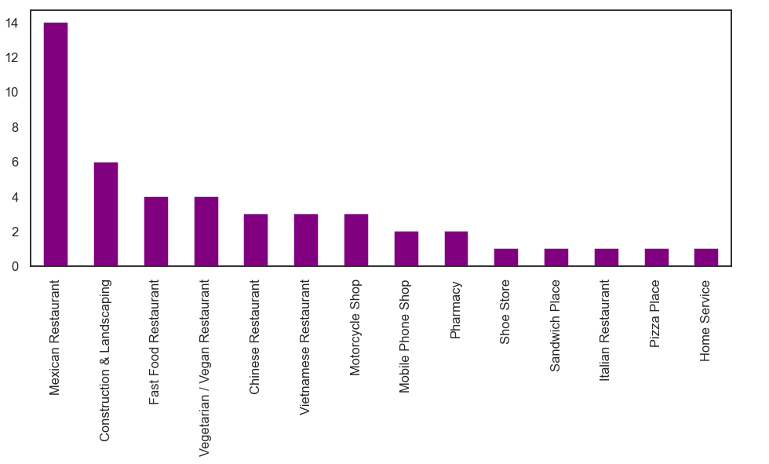
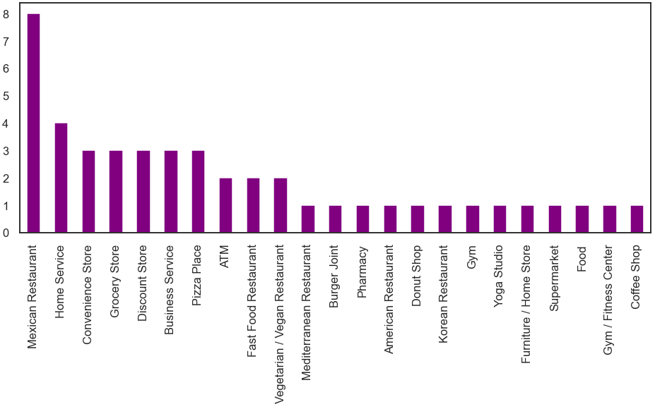
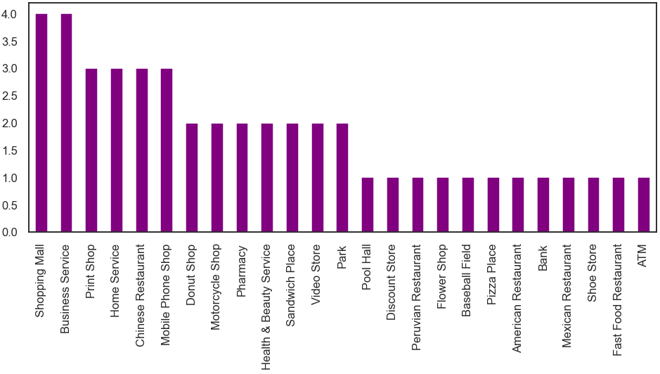
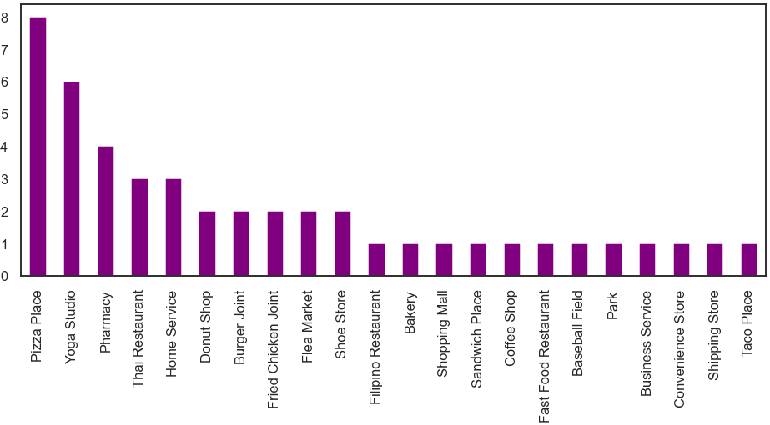
Top 4 most common avenues for cluster 2
1
2
3
4

Slide 18
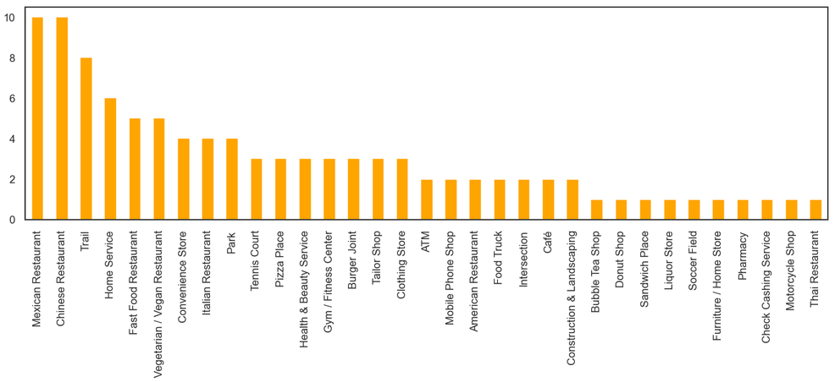
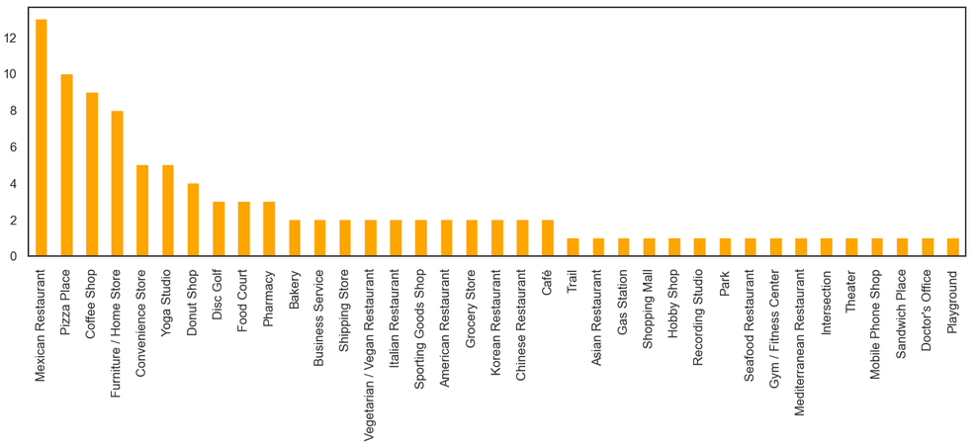
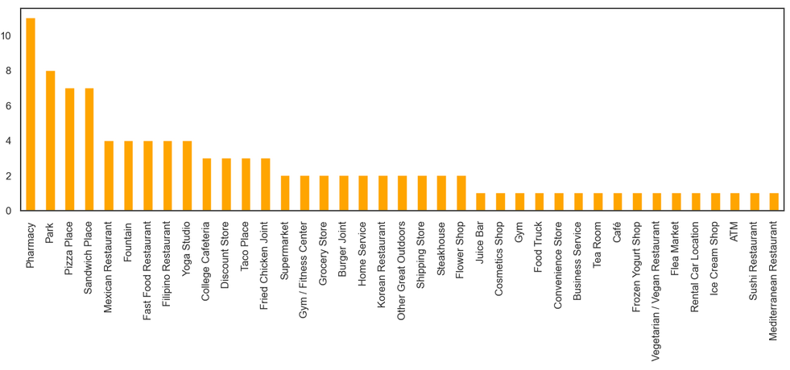
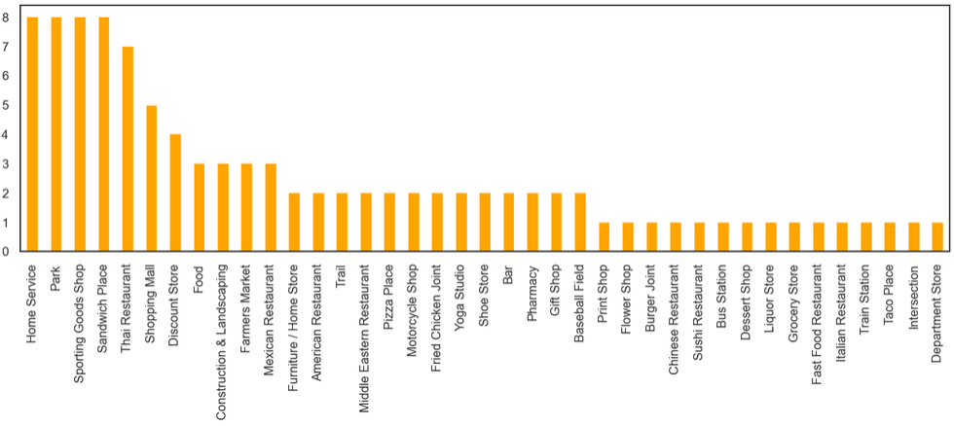
Top 4 most common avenues for cluster 3
1
2
3
4

Slide 19
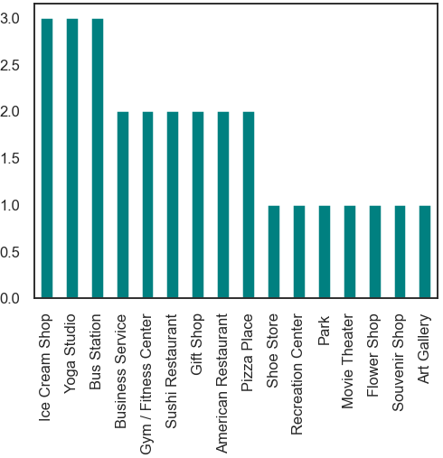
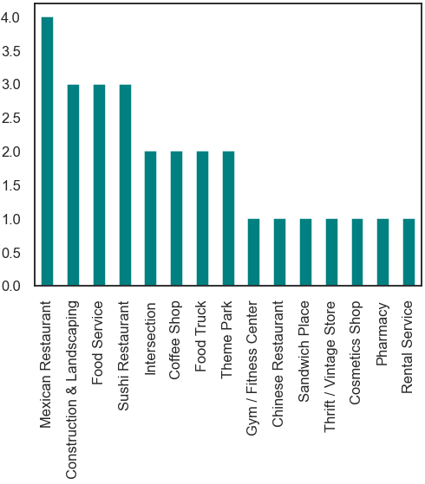
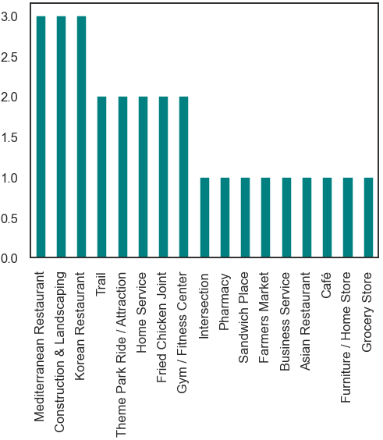
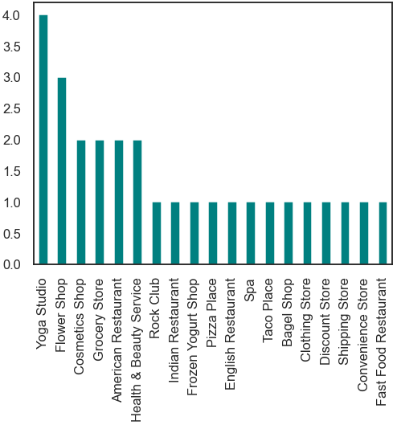
Top 4 most common avenues for cluster 4
3
2
1
4

Slide 20
summary
Out of the four clusters identified,
Cluster 1: The neighborhood in this cluster are suitable for those who like a scenic surroundings with park, and natural landscapes with low crime rate (shooting incidents), and moderate population with slightly higher age group.
Cluster 2: The neighborhood in this cluster involves high shooting incidents, lower age group individuals, high population, with lot of restaurants and shopping complexes.
Cluster 3: The neighborhood in this cluster involves moderately high shooting incidents, second lower age group individuals in the cluster, high population, with lot of restaurants and other businesses.
Cluster 4: The neighborhood in this cluster are suitable for those who like restaurants involving different cuisines, health clubs, seeking safe, and low crime rate (shooting incidents), and very low population density with slightly higher age group individuals
As illustrated in this short exercise, with additional data one can create more meaningful clusters to place relocating people in suitable clusters to help narrow down their search. In that sense, this is a capstone project and a small proof of concept demonstrating the feasibility of this kind of idea.

Slide 21
Recommendations
Adding more datasets to the study will help bring out additional features and criteria
As an example, adding more crime related datasets like burglary etc. in addition to just shooting incidents
Adding more dataset related to people of special needs
Adding features related to senior / adult assisted living
Adding more features will also help form better, and more meaningful clusters
Expanding the region to include larger area, adding more zip codes could help form larger, and possibly better clusters
The same concept can be extended to include epidemic / outbreak related incidents which would be particularly helpful during a pandemic such as Covid-19
The same concept can be extended to help people who travel for vacation by taking the interests of people and combining transportation related data

